Slide 1
SARIMA Model For Predicting Wind Speed and Damages
Team 12 - Hodges, Muharemovic, Tang, Zhang

Slide 2
TABLE OF CONTENTS
01
Initial Findings
03
SARIMA Model
02
Random Walk
04
Insights and Conclusion
Basic data analysis elucidates the patterns in the data
Forecast Wind Speeds of Ganopolis
Predict Damages and Finance
Findings for optimized insurance strats and profits for Insura Corp

Slide 3
01
Initial Findings
Rudimentary Data Analysis

Slide 4
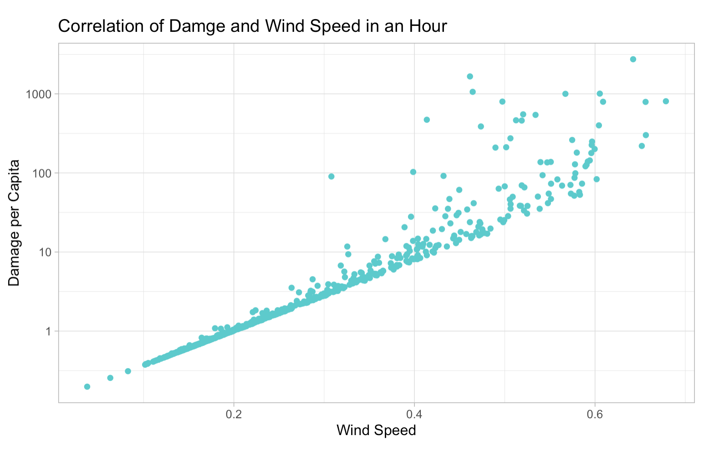
Damage and Wind Speed Regression
Exponential regression
Weighted by damage
Covariance increases as wind speed increases

Slide 5
02
Random Walk
Measuring Fluctuation

Slide 6
What is a Random Walk Model?
Next val assume same as last
Use previous to forecast next
Simple and easy to capture trend between 2 variables
Cons: Not good for data with clear trends, and bad at long term predictability
Notes:
-previous value to forecast the next time step
-good at capturing fluctations
-bad at capturing long term trends bc it captures the point to point fluctuations
-univariate model which means you can only use one explanatory variable and one response variable

Slide 7
Final Application
Captures the variance in the wind speeds to calculate the catastrophe damage, ie maximum damage, which should be used to calculate the monthly insurance.

Slide 8
03
SARIMA Model
Leveraging Daily Patterns

Slide 9
What is a SARIMA Model?
Seasonal - Leverages daily fluctuations to predict wind speeds
Doesn’t fluctuate as violently as wind usually does

Slide 10
SARIMA model incorporates seasonality in time series data (good for multiple variables) in comparison to ARIMA
Strengths: Handles both trend and seasonality

Slide 11
04
Insights and Conclusion
Leveraging Daily Patterns

Slide 12
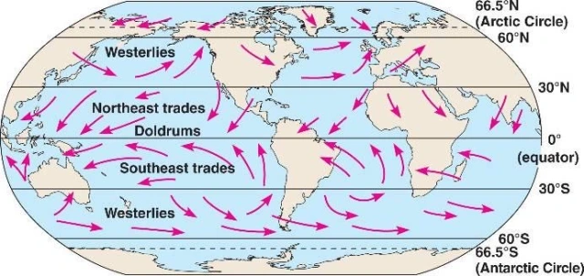
Insights:
Wind speed fluctuates depending on time of day
Wind speed has high correlation with pressure
Damage has exponential relationship to wind speed
More variable models should be used to capture the violent fluctuations

Slide 13
Financial Regression
Impact in insurance, construction, agriculture, and transportation, and tourism
Wind Speed positively correlated with damage
Combined the model and the pricing formula to get a good regression model

Slide 14
Random Walk
SARIMA
Catastrophe Analysis
Wind Pattern Analysis
Pricing

